Slide 1
JSP CRUD OPERATION CODE AND OUTPUT Snippet

Slide 2
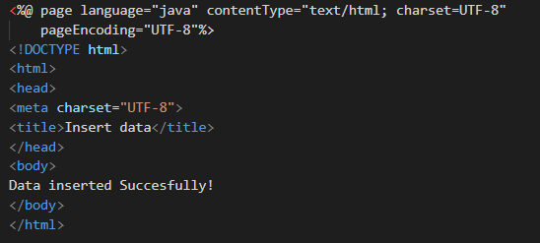
Insert_succesfully.jsp (CODE)

Slide 3
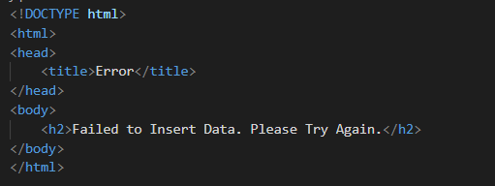
error.jsp (CODE)

Slide 4
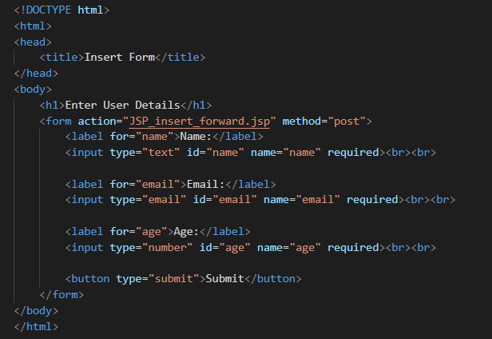
Insert_form_forward.jsp (CODE)

Slide 5
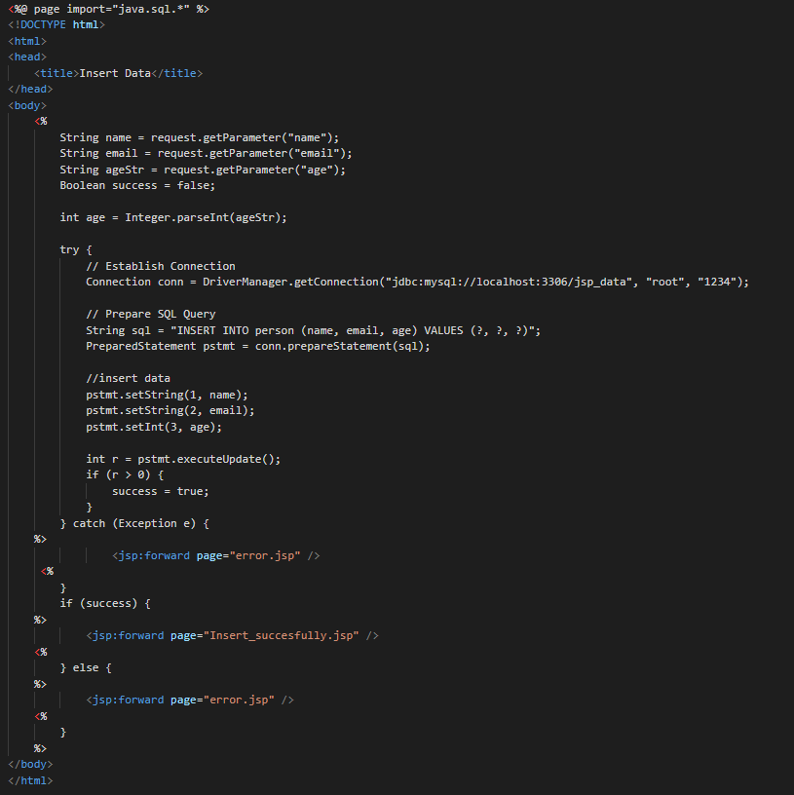
JSP_insert_forward.jsp (CODE)

Slide 6
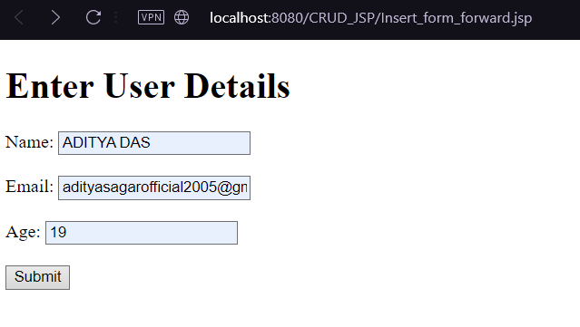
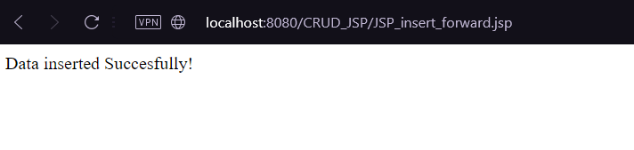
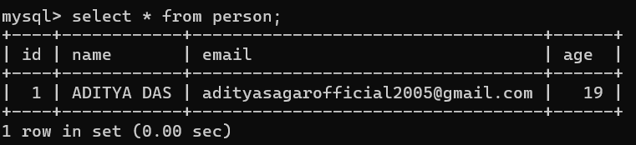

Insert_successfully.jsp, error.jsp, Insert_form_forward.jsp, JSP_insert_forward.jsp (OUTPUT)
After (DATA insertion in mysql):-
Before (DATA insertion in mysql):-

Slide 7
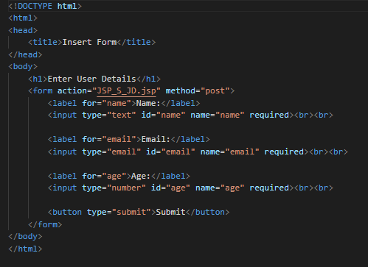
Insert_form.jsp (CODE)

Slide 8
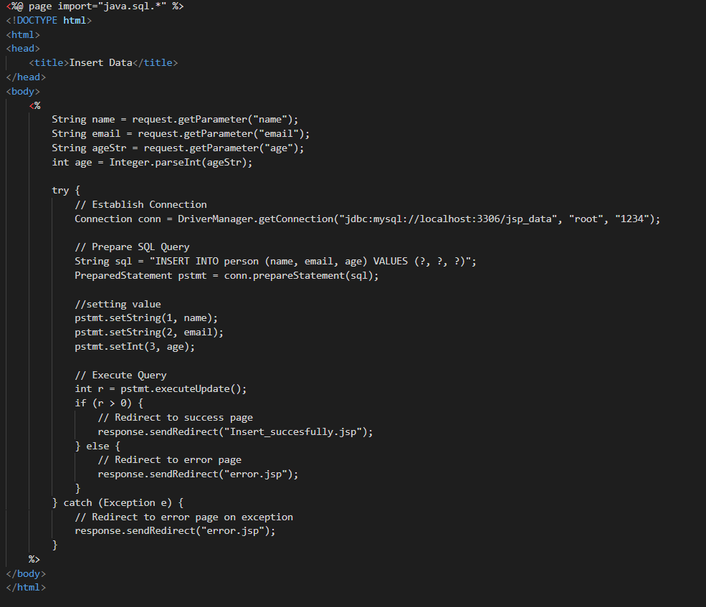
JSP_S_JD.jsp (CODE)

Slide 9
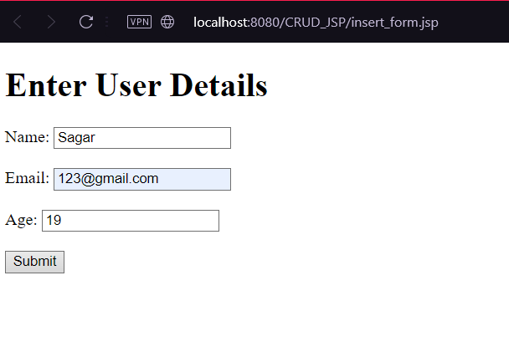
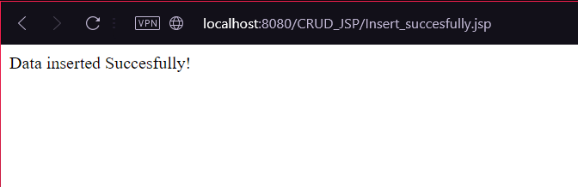
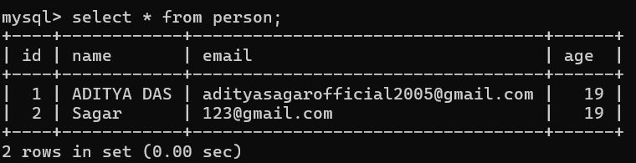
Insert_successfully.jsp, error.jsp, Insert_form.jsp, JSP_S_JD.jsp (OUTPUT)
Before (DATA insertion in mysql):-
After (DATA insertion in mysql):-

